Slide 1


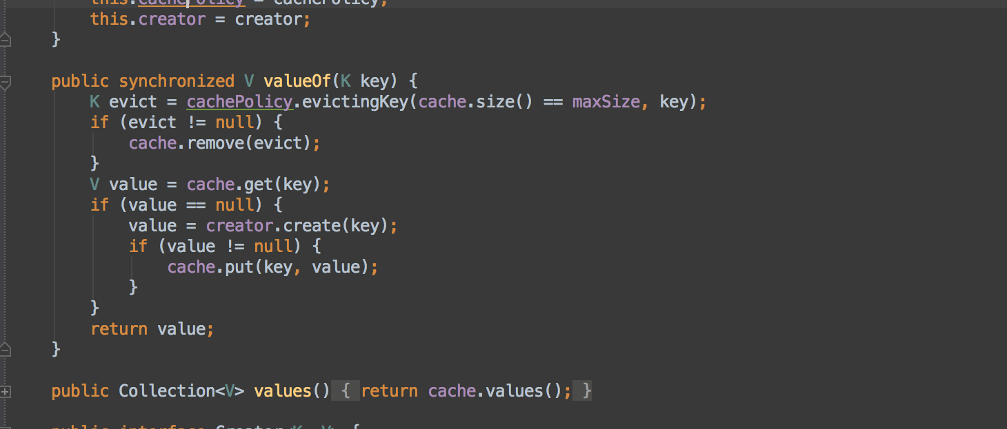


Functional Programming
LINQ
Advanced
C#
SoftUni Team
Technical Trainers
Software University
http://softuni.bg

Slide 2

Table of Contents
LINQ Queries
Simple Operations
Harder Operations
λ

Slide 3
Questions
sli.do #CSharp-Advanced

Slide 4





LINQ to *
C#
VB.NET
Others …
.NET Language-Integrated Query (LINQ)
LINQ enabled data sources
LINQ enabled ADO.NET
LINQ to Objects
LINQ to DataSets
LINQ
to SQL
LINQ to
Entities
LINQ
to XML
<book>
<title/>
<author/>
<price/>
</book>
Objects
Relational Data
XML

Slide 5
LINQ: Simple Operations
Where()
Searches by given condition
First() / FirstOrDefault()
Gets the first matched element
Last() / LastOrDefault()
Gets the last matched element
Select()
Makes projection (conversion) to another type
OrderBy() / ThenBy() / OrderByDescending()
Orders a collection

Slide 6
LINQ: Simple Operations (2)
Any()
Checks if any element matches a condition
All()
Checks if all elements match a condition
Distinct()
Returns only the unique elements
Skip() / Take()
Skips or takes X number of elements

Slide 7
Problem: Take Two
Create a program that:
Reads a sequence of integers
Finds all unique elements, such that 10 ≤ n ≤ 20
Prints only the first 2 elements
15 2 15 14 12
15 14
17 -2 3
17
-2 3
(no output)
Check your solution here: https://judge.softuni.bg/Contests/Compete/Index/598#0

Slide 8
Solution: Take Two
Console.ReadLine()
.Split(' ')
.Select(int.Parse)
.Where(n => n >= 10 && n <= 20)
.Distinct()
.Take(2)
.ToList()
.ForEach(n => Console.Write(n + " "));
Check your solution here: https://judge.softuni.bg/Contests/Compete/Index/598#0

Slide 9
Problem: UPPER STRINGS
Read a sequence of strings
Map each to upper case and print them
Use LINQ
Pesho Gosho Stefan
PESHO GOSHO STEFAN
Soft Uni Rocks
SOFT UNI ROCKS
Check your solution here: https://judge.softuni.bg/Contests/Compete/Index/598#0

Slide 10
Solution: UPPER STRINGS
Console.ReadLine()
.Split(' ')
.Select(w => w.ToUpper())
.ToList()
.ForEach(w => Console.Write(w + " "));
Check your solution here: https://judge.softuni.bg/Contests/Compete/Index/598#0

Slide 11
Problem: First Name
Read a sequence of names
Read a sequence of letters
Of the names that start with one of the letters find the first name (ordered lexicographically)
Rado Plamen Gosho
p r
Plamen
Plamen Gosho Rado
s c
No match
Check your solution here: https://judge.softuni.bg/Contests/Compete/Index/598#0

Slide 12
Solution: First Name
string name = String.Empty;
foreach (var letter in letters)
{
name = names.Where(w => w.ToLower()
.StartsWith(letter.ToLower()))
.FirstOrDefault();
if (name != null)
Console.WriteLine(name); break;
}
if (name == null) Console.WriteLine("No match");
Check your solution here: https://judge.softuni.bg/Contests/Compete/Index/598#0

Slide 13
Problem: Average of Doubles
Read a sequence of double numbers
Find the average of all elements
Use the Stream API
Round to second digit
3 4 5 6
4.50
3.14 5.2 6.18
4.84
(empty sequenece)
No match
Check your solution here: https://judge.softuni.bg/Contests/Compete/Index/598#0

Slide 14
Solution: Average of Doubles
var average = Console.ReadLine()
.Split(' ')
.Select(double.Parse)
.Average();
Console.WriteLine($"{average:f2}");
Check your solution here: https://judge.softuni.bg/Contests/Compete/Index/598#0

Slide 15
Problem: Min Even Number
Read a sequence of numbers
Find the min of all even numbers
Use the LINQ
1 2 3 4 5 6
2.00
3.14 -2.00 1.33
-2.00
(empty list)
No match
Check your solution here: https://judge.softuni.bg/Contests/Practice/Index/465#0

Slide 16
Solution: Min Even Number
Optional<Double> min = Arrays.stream( scanner.nextLine().split("\\s+"))
.filter(n -> !n.isEmpty())
.map(Double::valueOf)
.filter(n -> n % 2 == 0)
.min(Double::compare);
Check your solution here: https://judge.softuni.bg/Contests/Practice/Index/465#0

Slide 17
Problem: Find and Sum Integers
Read a sequence of elements
Find the sum of all integers
Use the LINQ
Sum 3 and 4
7
Sum -3 and -4
-7
Sum three and four
No match
Check your solution here: https://judge.softuni.bg/Contests/Practice/Index/465#0

Slide 18
Solution: Find and Sum Integers
var numbers = input.Split(' ')
.Select(n => {
long value;
bool success = long.TryParse(n, out value);
return new {value, success};})
.Where(b => b.success)
.Select(x => x.value)
.ToList();
//Print sum if there is elements in list
Check your solution here: https://judge.softuni.bg/Contests/Practice/Index/465#0

Slide 19
GroupBy()
Transforms a collection into groups. Each group has a key.
In the example above we have List<> of IGrouping<K, V>.
List<IGrouping<bool, int>> groups =
arr.GroupBy(num => num % 2 == 0)
.ToList()
foreach(var group in groups)
{
Console.WriteLine(“Is even: {0} - ”, group.Key);
Console.WriteLine(string.Join(“, ”, group));
}

Slide 20
ToDictionary()
Transforms a collection to dictionary
In this example we transformed the List<IGrouping<K, V>>
from the previous slide to Dictionary<K, List<V>>.
Dictionary<bool, List<int>> dict =
arr.GroupBy(num => num % 2 == 0)
.toDictionary(g => g.Key, g => g.ToList());

Slide 21
Problem: Map Districts
You are given population count of districts in different cities
Print all cities with population greater than a given bound
Print top 5 districts for a given city
Sort cities and districts by descending population
Pld:9 Pld:13 Has:7 Sof:20 Sof:10 Sof:15
10
Population greater than 10
Sof: 20 15 10
Pld: 13 9

Slide 22
Solution: Map Districts
Dictionary<string, List<long>> towns = new Dictionary<string, List<long>>();
var elements = Console.ReadLine().Split(new char[] { ' ' });
foreach (var element in elements)
{
var info = element.Split(':');
var town = info[0];
var population = long.Parse(info[1]);
if (!towns.ContainsKey(town))
{
towns.Add(town, new List<long>());
}
towns[town].Add(population);
}

Slide 23
Solution: Map Districts (2)
var bound = long.Parse(Console.ReadLine());
towns = towns
.Where(t => t.Value.Sum() > bound)
.OrderByDescending(t => t.Value.Sum())
.ToDictionary(x => x.Key, x => x.Value);

Slide 24
Solution: Map Districts (3)
foreach (var town in towns)
{
var districts = town.Value
.OrderByDescending(x => x)
.Take(5);
Console.WriteLine(string.Format(
"{0}: {1}",
town.Key,
string.Join(" ", districts)));
}

Slide 25

GroupBy() and ToDictionary()
Exercises in class

Slide 26
SelectMany()
Collapses multiple collections to a single collection
Here we’ve combined all of the lists in the dictionary to a single array of integers.
Dictionary<bool, List<int>> dict =
new Dictionary<bool, List<int>>()
int[] arr2 =
dict.SelectMany(key => key.Value).ToArray()

Slide 27
Zip()
Operates over 2 collections in parallel
Here we added the values of the 2 arrays.
int[] arr = new int[] {1, 2, 3, 4, 5};
int[] arr2 = new int[] {5, 4, 3, 2, 1};
int[] result = arr.Zip(arr2, (a, b) => (a + b));

Slide 28
SelectMany() and Zip()
Exercises in class

Slide 29







Sets and Dictionaries
https://softuni.bg/trainings/1633/csharp-advanced-may-2017

Slide 30

License
This course (slides, examples, demos, videos, homework, etc.) is licensed under the "Creative Commons Attribution-NonCommercial-ShareAlike 4.0 International" license
Attribution: this work may contain portions from
"Fundamentals of Computer Programming with C#" book by Svetlin Nakov & Co. under CC-BY-SA license
"OOP" course by Telerik Academy under CC-BY-NC-SA license

Slide 31






Free Trainings @ Software University
Software University Foundation – softuni.org
Software University – High-Quality Education, Profession and Job for Software Developers
softuni.bg
Software University @ Facebook
facebook.com/SoftwareUniversity
Software University @ YouTube
youtube.com/SoftwareUniversity
Software University Forums – forum.softuni.bg

